Slide 1

Data
The independent variables used are,
Unemployment rate
Household Median Income
Percent of adults with less than a high school diploma
Percent of adults with a high school diploma only
Percent of adults completing some college or associate degree
Percent of adults with a bachelor's degree or higher
Obesity Prevalence Percent
Leisure Time Physical Inactivity Prevalence Percent
Median Age
The dependent variable
Diagnosed Diabetes Est. Percent

Slide 2
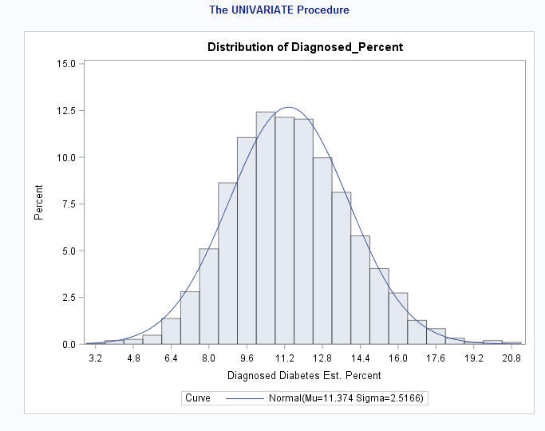
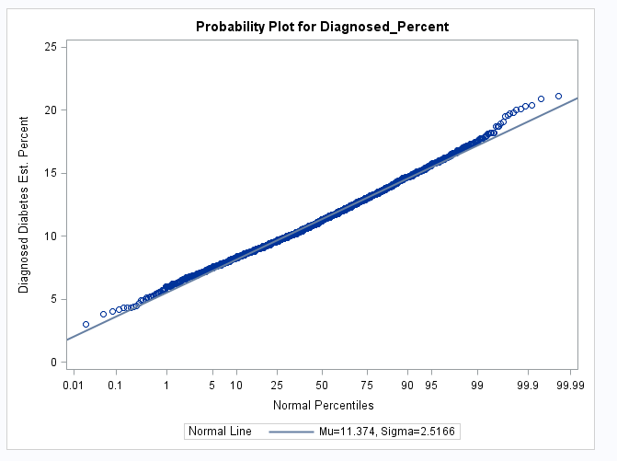
Histogram
Distribution of Diagnose percent looks normal and symmetric

Slide 3
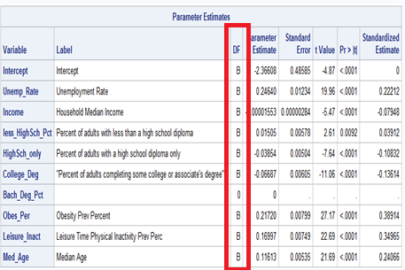
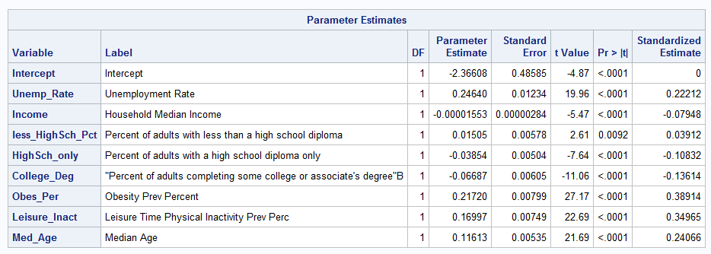
Regression Analysis
Here, the bachelor degree data is biased. Hence, it has been removed from the model
Fig 1 Fig 2

Slide 4
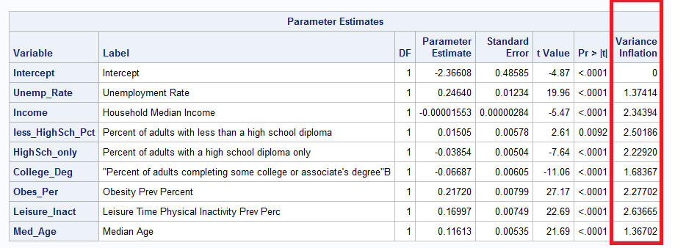
Multicollinearity

Slide 5
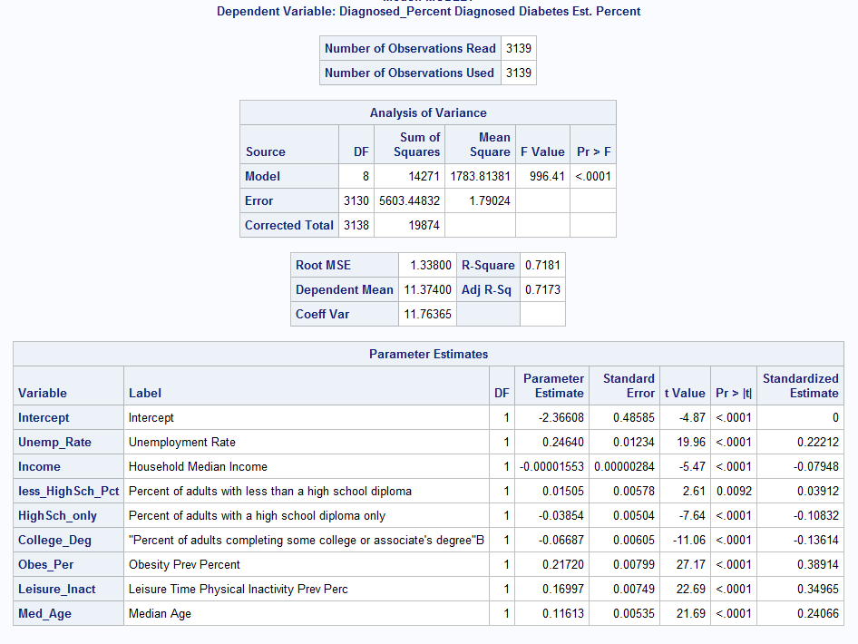
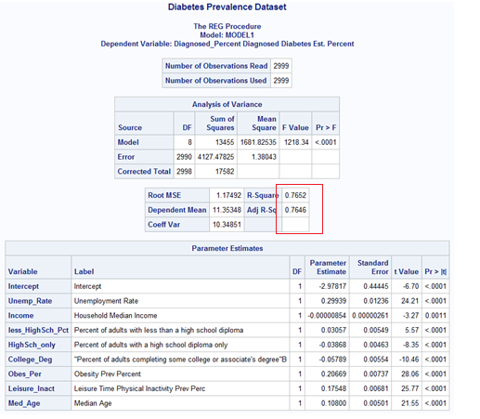

Regression model
Fig 1 : With Outliers &Influential points
Fig 2 : After removing Outliers &influential points

Slide 6
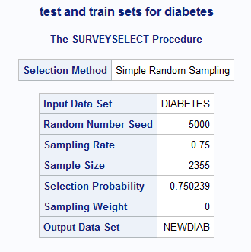
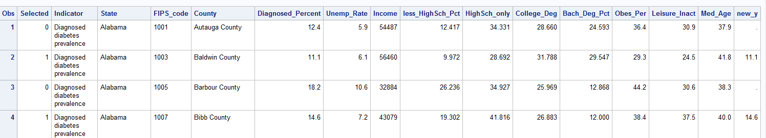

Train and test data
Train – 75% & Test -25% (Fig 1)
New_y variable has been created (Fig 2)
Fig 1
Fig 2

Slide 7
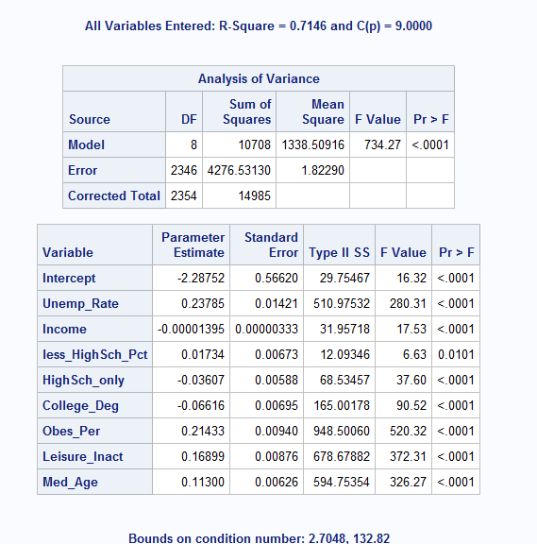
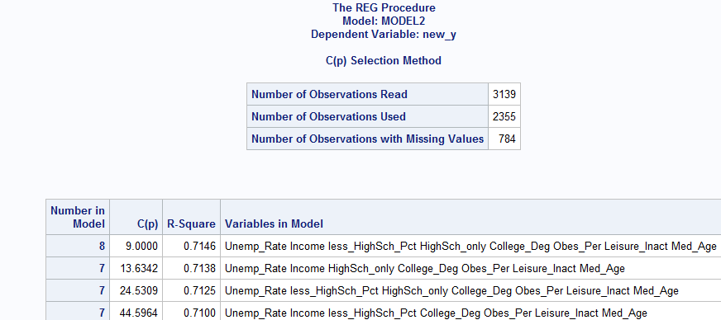

Model selection Comparison
Model 1 : Backward
Model 2: cp

Slide 8
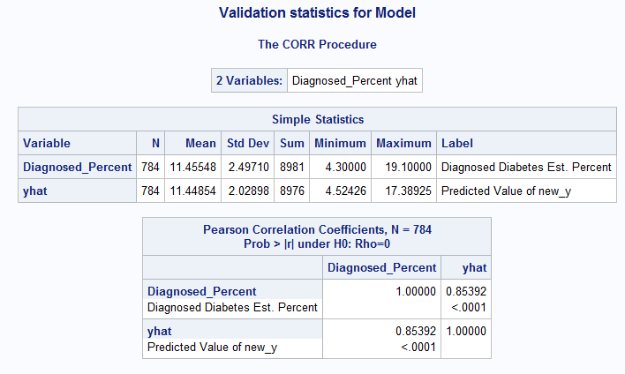

Test data validation
 | Model
Train | RMSE | 1.15341
 | R square | 0.7672
 | Adj-R-Square | 0.7663
 | GOF | ok
 | Residuals | ok
Test | RMSE | 1.35015
 | MAE | 0.98005
 | R square | 0.7146
 | Adj-R-Square | 0.7136
 | CV-R-square | 0.038020634

Slide 9
Final Model
The model equation is the following,
Diagnose_Percent = -2.94 + 0.28 Unemp_Rate - 0.00001 Income +0.036 less_Highsch_Pct -0.04 highsch_only – 0.05Col_Degree + 0.20 Obes_per + 0.1735 Leisure_Ianct + 0.11 Med_Age

